Slide 1

Programming Languages
Third Edition
Chapter 10
Control II – Procedures and Environments

Slide 2
Objectives
Understand the nature of procedure definition and activation
Understand procedure semantics
Learn parameter-passing mechanisms
Understand procedure environments, activations, and allocation
Understand dynamic memory management
Programming Languages, Third Edition

Slide 3
Objectives (cont’d.)
Understand the relationship between exception handling and environments
Learn to process parameter modes in TinyAda
Programming Languages, Third Edition

Slide 4
Introduction
Procedures and functions: blocks whose execution is deferred and whose interfaces are clearly specified
Many languages make strong syntactic distinctions between functions and procedures
Can make a case for a significant semantic distinction as well:
  Functions should produce a value only have no side effects
  Procedures produce no values and operate by producing side effects
Programming Languages, Third Edition

Slide 5
Introduction (cont’d.)
Procedure calls are therefore statements, while function calls are expressions
Most languages do not enforce semantic distinctions
  Functions can produce side effects as well as return values
  Procedures may produce values through their parameters while causing no side effects
We will not make a significant distinction between them since most languages do not
Programming Languages, Third Edition

Slide 6
Introduction (cont’d.)
Functional languages generalize the notion of a function
  Functions are first-class data objects themselves
Functions require dynamic memory management, including garbage collection
Activation record: the collection of data needed to maintain a single execution of a procedure
Programming Languages, Third Edition

Slide 7
Procedure Definition and Activation
Procedure: a mechanism for abstracting a group of actions or computations
Body of the procedure: the group of actions
Procedure name: represents the body
A procedure is defined by providing a specification (or interface) and a body
Specification: includes the procedure name, types and names of the formal parameters, and the return value type (if any)
Programming Languages, Third Edition

Slide 8
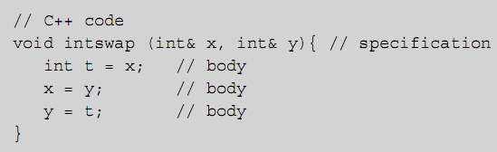
Procedure Definition and Activation (cont’d.)
Example: in C++ code
In some languages, a procedure specification can be separated from its body
  Example:
Programming Languages, Third Edition

Slide 9
Procedure Definition and Activation (cont’d.)
You call (or activate) a procedure by stating its name and providing arguments to the call which correspond to its formal parameters
  Example:
A call to a procedure transfers control to the beginning of the body of the called procedure (the callee)
When execution reaches the end of the body, control is returned to the caller
  May be returned before the end of the body by using a return-statement
Programming Languages, Third Edition

Slide 10
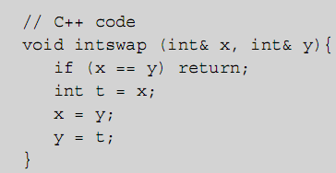
Procedure Definition and Activation (cont’d.)
Example:
In FORTRAN, procedures are called subroutines
Functions: appear in expressions and compute returned values
Programming Languages, Third Edition

Slide 11
Procedure Definition and Activation (cont’d.)
A function may or may not change its parameters and nonlocal variables
In C and C++, all procedures are implicitly functions
  Those that do not return values are declared void
In Ada and FORTRAN, different keywords are used for procedures and functions
Some languages allow only functions
  All procedures must have return values
  This is done in functional languages
Programming Languages, Third Edition

Slide 12
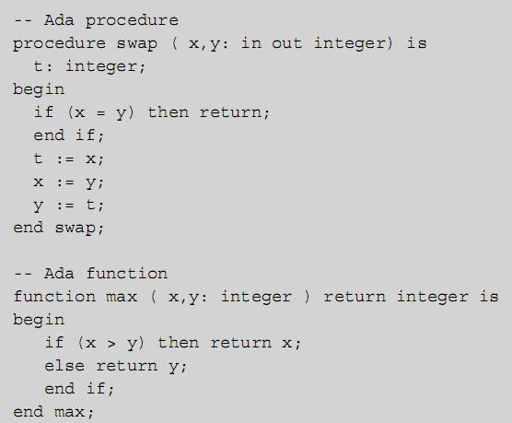
Procedure Definition and Activation (cont’d.)
Programming Languages, Third Edition

Slide 13
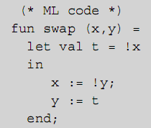
Procedure Definition and Activation (cont’d.)
In ML, procedure and function declarations are written in a form similar to constant declarations
A procedure declaration creates a constant procedure value and associates a symbolic name with that value
Programming Languages, Third Edition

Slide 14
Procedure Definition and Activation (cont’d.)
A procedure communicates with the rest of the program through its parameters and also through nonlocal references (references to variables outside the procedure body)
Scope rules that establish the meanings of nonlocal references were covered in Chapter 7
Programming Languages, Third Edition

Slide 15
Procedure Semantics
Semantically, a procedure is a block whose declaration is separated from its execution
The environment determines memory allocation and maintains the meaning of names during execution
  Memory allocated for local objects of a block are called the activation record (or stack frame)
  The block is said to be activated as it executes
When a block is entered during execution, control transfers into the block’s activation
Programming Languages, Third Edition

Slide 16
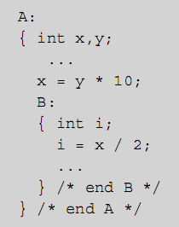
Procedure Semantics (cont’d.)
Example: in C code
  Blocks A and B are executed as they are encountered
When a block is exited, control transfers back to the surrounding block, and the activation record of the exiting block is released
Programming Languages, Third Edition

Slide 17
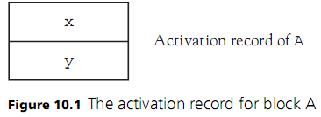
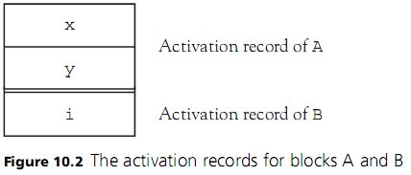
Procedure Semantics (cont’d.)
Programming Languages, Third Edition

Slide 18

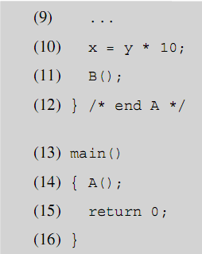
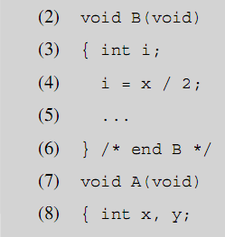
Procedure Semantics (cont’d.)
Example: B is a procedure called from within A
Programming Languages, Third Edition

Slide 19
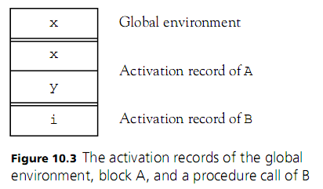
Procedure Semantics (cont’d.)
Programming Languages, Third Edition

Slide 20
Procedure Semantics (cont’d.)
Defining environment (or static environment) of B is the global environment
Calling environment (or dynamic environment) of B is the activation record of A
For blocks that are not procedures, the defining and calling environments are always the same
A procedure can have any number of calling environments during which it will retain the same defining environment
Programming Languages, Third Edition

Slide 21
Procedure Semantics (cont’d.)
A nonprocedure block communicates with its surrounding block via nonlocal references
  Lexical scoping allows it to access all variables in the surrounding block that are not redeclared in its own declarations
A procedure block can only communicate with its defining block via references to nonlocal variables
  It has no way of directly accessing the variables in its calling environment
  It communicates with its calling environment through its parameters
Programming Languages, Third Edition

Slide 22
Procedure Semantics (cont’d.)
Parameter list is declared with the definition of the procedure
  Parameters do not take on any value until they are replaced by arguments when the procedure is called
Parameters are also called formal parameters, while arguments are called actual parameters
One could make the case that procedures should communicate only using their parameters and should never use or change a nonlocal variable
  To avoid dependencies (use) or side effects (change)
Programming Languages, Third Edition

Slide 23
Procedure Semantics (cont’d.)
While this is a good rule for variables, it is not good for functions and constants
Closed form: procedures that depend only on parameters and fixed language features
Closure: the code of a function together with a representation of its defining environment
  Can be used to resolve all outstanding nonlocal references relative to the body of the function
  Runtime environment must compute closures for all functions when needed
Programming Languages, Third Edition

Slide 24
Parameter-Passing Mechanisms
The nature of the bindings of arguments to parameters affects the semantics of procedure calls
Languages differ significantly in the kinds of parameter-passing mechanisms available and the range of permissible implementation effects
Four mechanisms will be discussed:
  Pass by value
  Pass by reference
  Pass by value-result
  Pass by name
Programming Languages, Third Edition

Slide 25
Pass by Value
Pass by value: most common mechanism for parameter passing
  Arguments are evaluated at time of call, and their values become the values of the parameters
In the simplest form of pass by value, value parameters behave as constant values during execution of the procedure
Pass by value: a process in which all parameters in the procedure body are replaced by the corresponding argument values
Programming Languages, Third Edition

Slide 26
Pass by Value (cont’d.)
This mechanism is usually the only mechanism used in functional languages
It is the default mechanism in C++ and Pascal and essentially the only mechanism in C and Java
They use a slightly different interpretation of pass by value
  Parameters are viewed as local variables of the procedure, with initial values given by argument values
  Value parameters may be assigned but cause no changes outside the procedure
Programming Languages, Third Edition

Slide 27

Pass by Value (cont’d.)
In Ada, in parameters may not be assigned
Pass by value does not imply that changes outside the procedure cannot occur through the use of parameters
  A pointer or reference type parameter contains an address as its value, and this can be used to change memory outside the procedure
Example: in C code
Programming Languages, Third Edition

Slide 28

Pass by Value (cont’d.)
Note: assigning directly to the pointer parameter does not change the argument outside the procedure
In some languages, certain values are implicitly pointers or references
  Example: in C, arrays are implicitly pointers, so an array value parameter can be used to change values stored in the array
Programming Languages, Third Edition

Slide 29
Pass by Value (cont’d.)
In Java, object types are implicitly pointers, so an object parameter can be used to change its data
  Direct assignments to parameters are not allowed
Programming Languages, Third Edition

Slide 30
Pass by Reference
Pass by reference: passes the location of the variable, making the parameter an alias for the argument
  Any changes to the parameter occur to the argument as well
Is the default for FORTRAN
  Can be specified in C++ by using an ampersand (&) after the data type
  Can be specified in Pascal by using the var keyword before the variable name
Programming Languages, Third Edition

Slide 31
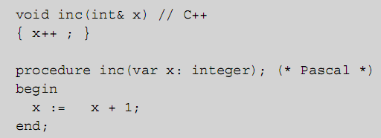
Pass by Reference (cont’d.)
Example:
  After a call to inc(a) the value of a has increased by 1 so that a side effect has occurred
Programming Languages, Third Edition

Slide 32
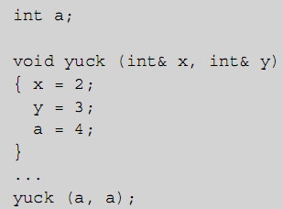
Pass by Reference (cont’d.)
Example: multiple aliasing is also possible
  Inside procedure yuck after the call, x, y, and a all refer to the same variable, namely a
Programming Languages, Third Edition

Slide 33
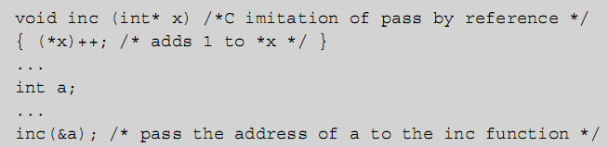
Pass by Reference (cont’d.)
Can achieve pass by reference in C by passing a reference or location explicitly as a pointer
  Note the necessity of explicitly taking the address of variable a and then explicitly dereferencing it again in the body of inc
Programming Languages, Third Edition

Slide 34
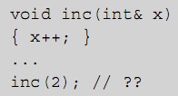
Pass by Reference (cont’d.)
How should reference arguments that are not variables be handled?
Example: in C++ code
  FORTRAN creates a temporary integer location, initializes it to the value 2, then applies the inc function
  This is an error in C++ and Pascal
Programming Languages, Third Edition

Slide 35
Pass by Value-Result
Pass by value-result:
  Value of the argument is copied and used in the procedure
  Final value of the parameter is copied back out to the argument location when the procedure exits
  Also called copy-in, copy-out, or copy-restore
Pass by value-result can only be distinguished from pass by reference when using aliasing
Programming Languages, Third Edition

Slide 36
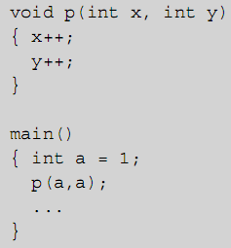
Pass by Value-Result (cont’d.)
Example: in C code
  If pass by reference, a has value 3 after p is called
  If pass by value-result, a has value 2 after p is called
Programming Languages, Third Edition

Slide 37
Pass by Value-Result (cont’d.)
Issues that must be addressed include:
  Order in which results are copied back to arguments
  Whether locations of arguments are calculated only on entry and stored, or are recalculated on exit
Another option is the pass by result mechanism:
  There is no incoming value, only an outgoing one
Programming Languages, Third Edition

Slide 38
Pass by Name and Delayed Evaluation
Pass by name: introduced in Algol60
  Intended as a kind of advanced inlining process for procedures
  Is essentially equivalent to normal order delayed evaluation
  Is difficult to implement and has complex interactions with other language constructs, especially arrays and assignment
It should be understood as a basis for the lazy evaluation studied in Chapter 3
Programming Languages, Third Edition

Slide 39
Pass by Name and Delayed Evaluation (cont’d.)
In pass by name, the argument is not evaluated until its actual use as a parameter in the called procedure
  The name of the argument replaces the name of the parameter to which it corresponds
The text of an argument at the point of call is viewed as a function, which is evaluated every time the corresponding parameter name is reached in the procedure
  However, the argument is always evaluated in the environment of the caller
Programming Languages, Third Edition

Slide 40
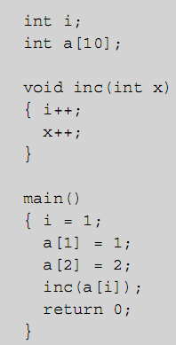
Pass by Name and Delayed Evaluation (cont’d.)
Example: in C code
  The result of this code is to set a[2] to 3, leaving a[1] unchanged
Programming Languages, Third Edition

Slide 41
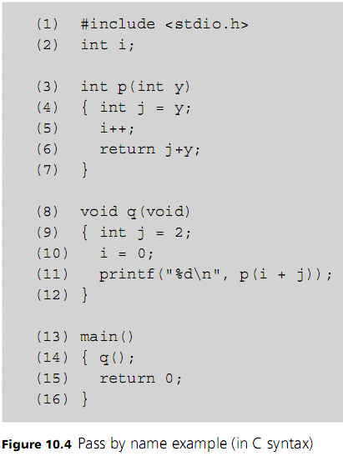
Programming Languages, Third Edition

Slide 42
Pass by Name and Delayed Evaluation (cont’d.)
Historically, the interpretation of pass by name arguments as functions to be evaluated when the procedure was called referred to the arguments as thunks
Pass by name is problematic when side effects are desired
Can exploit call by name in certain circumstances
  Jensen’s device: uses pass by name to apply an operation to an entire array
Programming Languages, Third Edition

Slide 43
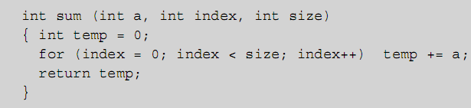

Pass by Name and Delayed Evaluation (cont’d.)
Example: Jensen’s device in C code:
  If a and index are pass by name parameters, this code will compute the sum of all elements x[0] through x[9]:
Programming Languages, Third Edition

Slide 44
Parameter-Passing Mechanism vs. Parameter Specification
Ada has two notions of parameter communication, in parameters and out parameters
  Any parameter can be declared in, out, or in out
  in parameter represents an incoming value only
  out parameter specifies an outgoing value only
  in out parameter specifies both incoming and outgoing value
Any parameter implementation can be used, as long as the appropriate values are communicated properly
  An in value on entry and an out value on exit
Programming Languages, Third Edition

Slide 45
Parameter-Passing Mechanism vs. Parameter Specification (cont’d.)
Any program that violates these protocols is erroneous
  in parameter cannot legally be assigned a new value
  out parameter cannot legally be used by the procedure
A translator can prevent many violations of parameter specifications
Programming Languages, Third Edition

Slide 46
Type Checking of Parameters
In strongly typed languages, procedure calls must be checked to ensure that arguments agree in type and number with the specified parameters
This means that:
  Procedures may not have a variable number of parameters
  Rules must be stated for type compatibility between parameters and arguments
For pass by reference, parameters usually must have the same type
  This can be relaxed for pass by value
Programming Languages, Third Edition

Slide 47
Procedure Environments, Activations, and Allocation
The environment for a block-structured language with lexical scope can be maintained in a stack-based fashion
  Activation record is created on the environment stack when a block is entered, and released when the block is exited
Same structure can be extended to procedure activations in which the defining and calling environments differ
Closure is necessary to resolve nonlocal references
Programming Languages, Third Edition

Slide 48
Procedure Environments, Activations, and Allocation (cont’d.)
Must understand this execution model to fully understand the behavior of programs
  Semantics of procedure calls are embedded in this model
A completely stack-based environment is not adequate to deal with procedure variables and dynamic creation of procedures
  Languages with these facilities (particularly functional languages) must use a more complex fully dynamic environment with garbage collection
Programming Languages, Third Edition

Slide 49
Fully Static Environments
In Fortran77, all memory allocation can be performed at load time
All variable locations are fixed throughout program execution
Function and procedure definitions cannot be nested
  All procedures/functions are global
Recursion is not allowed
All information associated with a function or subroutine can be statically allocated
Programming Languages, Third Edition

Slide 50
Fully Static Environments (cont’d.)
Each procedure or function has a fixed activation record containing space for local variables and parameters
Global variables are defined by COMMON statements
  They are determined by pointers to a common area
Programming Languages, Third Edition

Slide 51
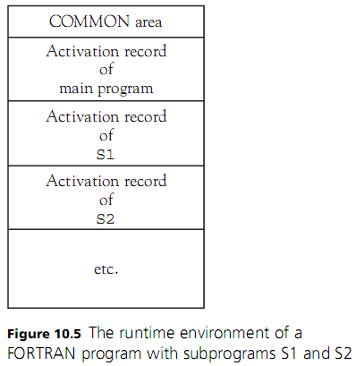
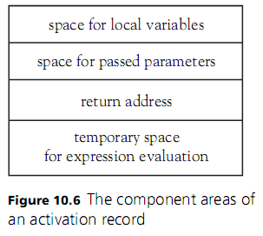
Fully Static Environments (cont’d.)
Programming Languages, Third Edition

Slide 52
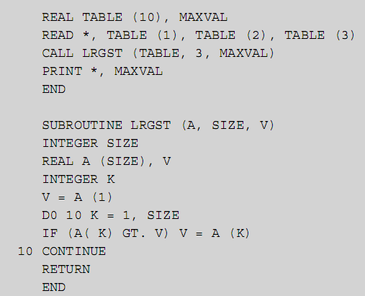
Fully Static Environments (cont’d.)
Programming Languages, Third Edition

Slide 53
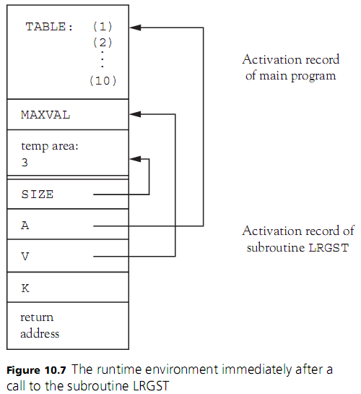
Programming Languages, Third Edition

Slide 54
Stack-Based Runtime Environments
In a block-structured language with recursion, activations of procedure blocks cannot be allocated statically
  A procedure may be called again before its previous activation is exited, so a new activation must be created on each procedure entry
A pointer to the current activation is required, since each procedure has no fixed location for its activation record
  Usually kept in a register called the environment pointer, or ep
Programming Languages, Third Edition

Slide 55
Stack-Based Runtime Environments (cont’d.)
Must also maintain a pointer to the activation record of the block from which the current activation was entered
  If a procedure call, this is the activation of the caller
The ep must be restored to point to the previous activation
  Previous location’s pointer is called the control link (or dynamic link)
Programming Languages, Third Edition

Slide 56
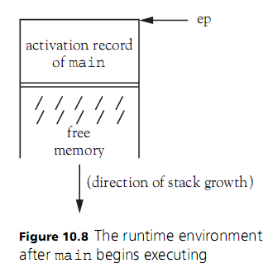
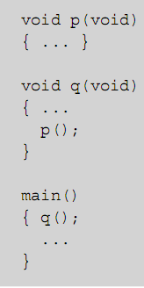
Stack-Based Runtime Environments (cont’d.)
Example: in C code
Programming Languages, Third Edition

Slide 57
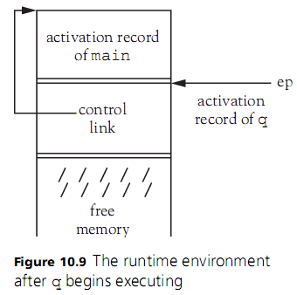
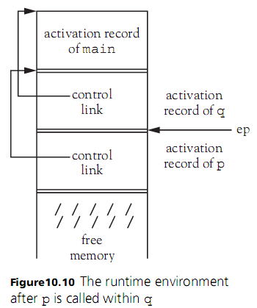
Stack-Based Runtime Environments (cont’d.)
Programming Languages, Third Edition

Slide 58
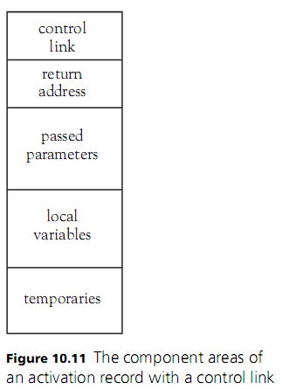
Stack-Based Runtime Environments (cont’d.)
The fields in each activation record need to contain this information:
Programming Languages, Third Edition

Slide 59
Stack-Based Runtime Environments (cont’d.)
Local variables are allocated in the current activation record, in the same order each time, because they are static
Each variable is thus allocated the same position in the activation record relative to the beginning of the record
  This is called the offset of the local variable
Programming Languages, Third Edition

Slide 60
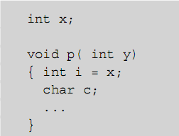
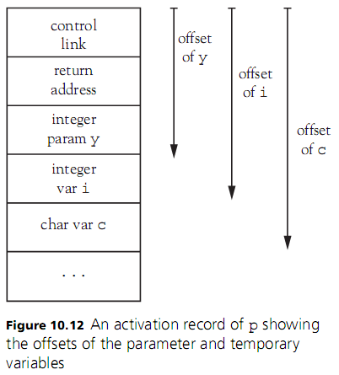
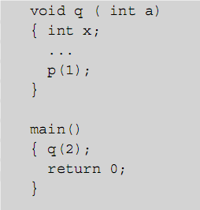
Stack-Based Runtime Environments (cont’d.)
Programming Languages, Third Edition

Slide 61
Stack-Based Runtime Environments (cont’d.)
Since procedures cannot be nested in FORTRAN or C, nonlocal references outside a procedure are actually global and are allocated statically
  No additional structures are required in the activation stack
When nested procedures are permitted, nonlocal references to local variables are permissible in a surrounding procedure scope
Programming Languages, Third Edition

Slide 62
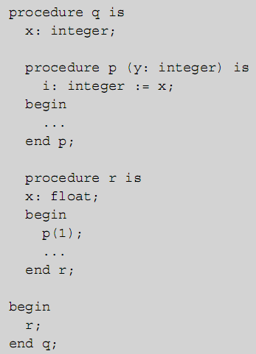
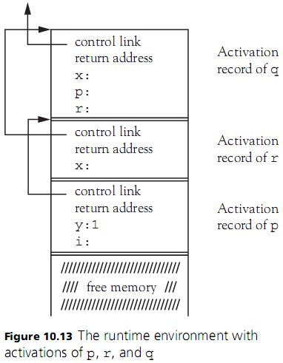
Stack-Based Runtime Environments (cont’d.)
Programming Languages, Third Edition

Slide 63
Stack-Based Runtime Environments (cont’d.)
To achieve lexical scope, a procedure must maintain a link to its lexical or defining environment
  This link is called the access link (or static link)
Each activation record needs an access link field
When blocks are deeply nested, it may be necessary to follow multiple access links to find a nonlocal reference
Programming Languages, Third Edition

Slide 64
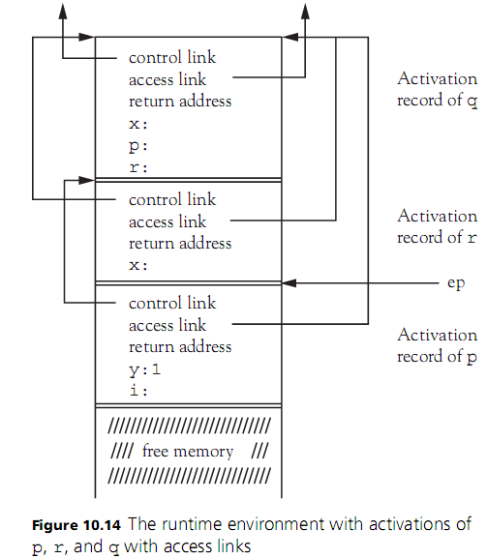
Programming Languages, Third Edition

Slide 65
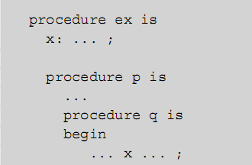
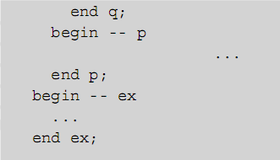
Stack-Based Runtime Environments (cont’d.)
Example: in Ada code
  To access x from inside q, must follow the access link in the activation record of q
  Then use the access link to the activation record of p
  Then follow the access link to the global environment
Programming Languages, Third Edition

Slide 66
Stack-Based Runtime Environments (cont’d.)
This process is called access chaining
The number of access links that must be followed corresponds to the difference in nesting levels (or nesting depth) between the accessing environment and the defining environment of the variable being accessed
Closure (the procedure code together with the mechanism for resolving nonlocal references) is significantly more complex
Programming Languages, Third Edition

Slide 67
Stack-Based Runtime Environments (cont’d.)
Closure requires two pointers:
  Code or instruction pointer (ip)
  Access link, or environment pointer of its defining environment (ep)
Closure will be denoted by <ep, ip>
Programming Languages, Third Edition

Slide 68
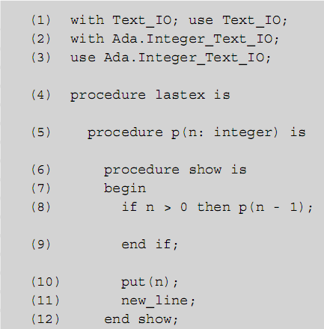
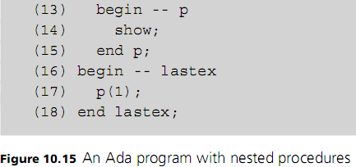
Programming Languages, Third Edition

Slide 69
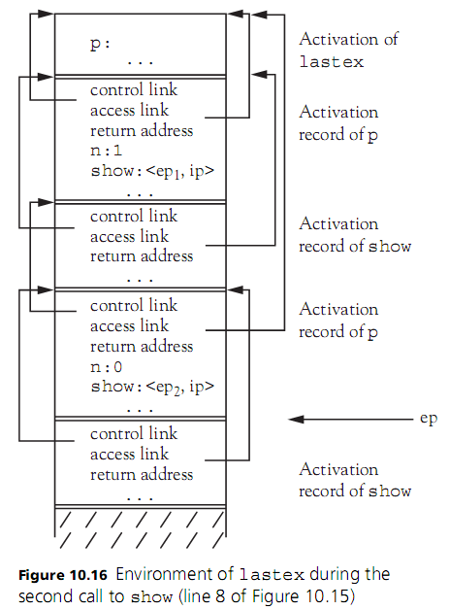
Programming Languages, Third Edition

Slide 70
Dynamically Computed Procedures & Fully Dynamic Environments
The use of <ep, ip> closures for procedures is suitable even for languages with procedures that are passed as parameters, as long as these parameters are value parameters
  The procedure passed as a parameter is passed as an <ep, ip> pair
  Its access link is the ep part of the closure
This approach is used in Ada and Pascal
A stack-based environment does have limitations
Programming Languages, Third Edition

Slide 71
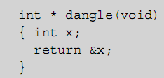
Dynamically Computed Procedures & Fully Dynamic Environments (cont’d.)
Any procedure that can return a pointer to a local object will result in a dangling reference when the procedure is exited
Example: in C code
  The assignment addr = dangle() will cause addr to point to an unsafe location in the activation stack
Programming Languages, Third Edition

Slide 72
Dynamically Computed Procedures & Fully Dynamic Environments (cont’d.)
Java does not allow this
Ada95 makes it an error by stating the Access-type Lifetime Rule:
  An attribute x’access yielding a result belonging to an access type T is only allowed if x can remain in existence at least as long as T
If procedures can be created dynamically and returned from other procedures, they become first-class values
  This flexibility is usually desired in a functional language
Programming Languages, Third Edition

Slide 73
Dynamically Computed Procedures & Fully Dynamic Environments (cont’d.)
A stack-based environment cannot be used, since the closure of a locally defined procedure will have an ep pointing to the current activation record
If this closure is available outside the activation of the creating procedure, the ep will point to an activation record that no longer exists
Programming Languages, Third Edition

Slide 74
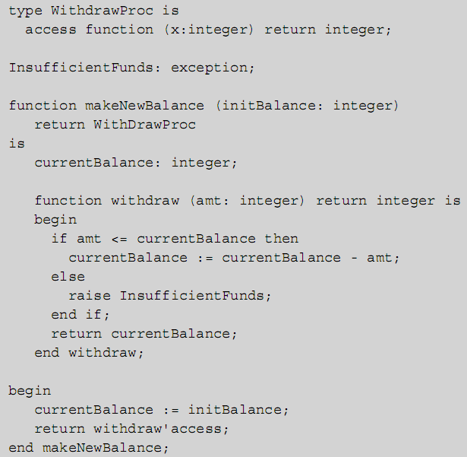
Programming Languages, Third Edition

Slide 75


Dynamically Computed Procedures & Fully Dynamic Environments (cont’d.)
After executing the following code:
  If we now execute this code:
  We should get 400 for newBalance1 and 50 for newBalance2
  If the two instances of the local currentBalance variable have disappeared from the environment, these calls will not work
Programming Languages, Third Edition

Slide 76
Dynamically Computed Procedures & Fully Dynamic Environments (cont’d.)
In LISP, functions and procedures are first-class values
  No nongeneralities or nonorthogonalities should exist
Fully dynamic environment: activation records are deleted only when they can no longer be reached from within the executing program
Must be able to reclaim unreachable storage
  Two methods for this are reference counts and garbage collection
Programming Languages, Third Edition

Slide 77
Dynamically Computed Procedures & Fully Dynamic Environments (cont’d.)
The structure of activation records becomes treelike instead of stacklike
  Control links to the calling environment no longer necessarily point to the immediately preceding activation
This is the model under which Scheme and other functional languages execute
Programming Languages, Third Edition

Slide 78
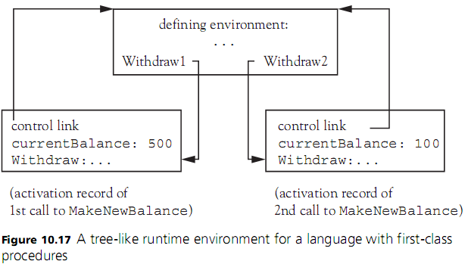
Dynamically Computed Procedures & Fully Dynamic Environments (cont’d.)
Programming Languages, Third Edition

Slide 79
Dynamic Memory Management
In a typical imperative language such as C, automatic allocation and deallocation of storage occurs only for activation records on a stack
Explicit dynamic allocation and use of pointers is available under manual programmer control using a memory heap separate from the stack
  Automatic garbage collection is desirable for the heap
Any language that does not apply significant restrictions to the use of procedures and functions must provide automatic garbage collection
Programming Languages, Third Edition

Slide 80
Dynamic Memory Management (cont’d.)
Two categories of automatic memory management:
  Reclamation of storage no longer used (previously called garbage collection)
  Maintenance of free space available for allocation
Programming Languages, Third Edition

Slide 81
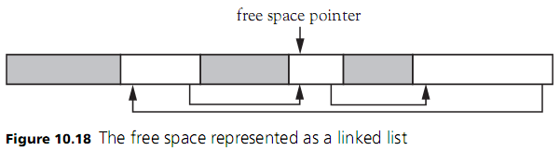
Maintaining Free Space
The free space in a contiguous block of memory provided to an executing program is maintained by using a list of free blocks
  Can be done via a linked list
Programming Languages, Third Edition

Slide 82
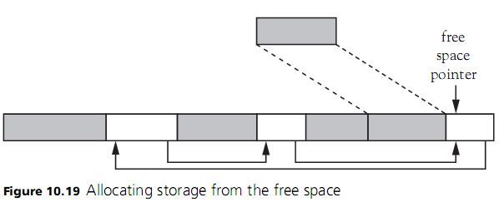
Maintaining Free Space (cont’d.)
Programming Languages, Third Edition

Slide 83
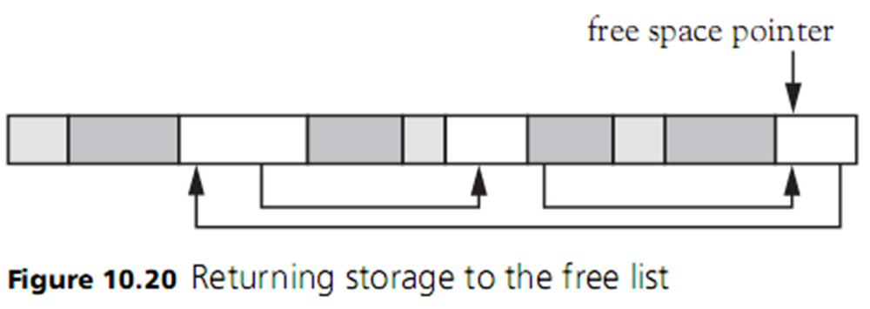
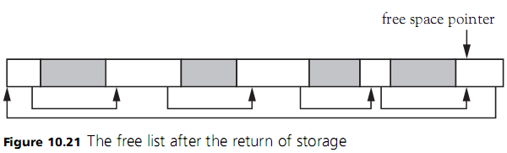
Maintaining Free Space (cont’d.)
Programming Languages, Third Edition

Slide 84
Maintaining Free Space (cont’d.)
Coalescing: process of joining immediately adjacent blocks of free memory to form the largest contiguous block of free memory
A free list can become fragmented
  This may cause the allocation of a large block to fail
Memory must occasionally be compacted by moving all free blocks together and coalescing them into one block
Storage compaction involves considerable overhead
Programming Languages, Third Edition

Slide 85
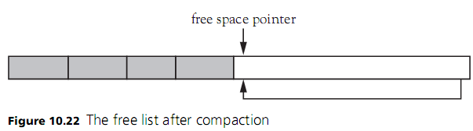
Maintaining Free Space (cont’d.)
Programming Languages, Third Edition

Slide 86
Reclamation of Storage
Two main methods for recognizing when a block of storage is no longer referenced:
  Reference counting
  Mark and sweep
Reference counting: an eager method of reclamation
  Each block of allocated storage contains a field that stores the count of references to that block from other blocks
  When count drops to 0, the block can be returned to the free list
Programming Languages, Third Edition

Slide 87
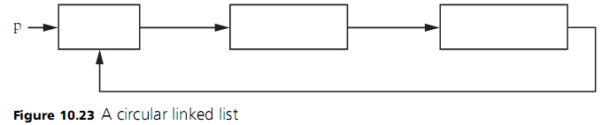
Reclamation of Storage (cont’d.)
Drawbacks of reference counting:
  Extra memory required to keep the counts
  Effort to maintain the counts is fairly large, because reference counts must be decremented recursively
  Circular references can cause unreferenced memory to never be deallocated
Programming Languages, Third Edition

Slide 88
Reclamation of Storage (cont’d.)
Mark and sweep: a lazy method that puts off reclaiming any storage until the allocator runs out of space
  It looks for all storage that can be referenced
  Moves all unreferenced storage back to the free list
Mark and sweep occurs in two passes:
  First pass follows all pointers recursively and marks each block of storage reached
  Second pass sweeps linearly through memory, returning unmarked blocks to the free list
Programming Languages, Third Edition

Slide 89
Reclamation of Storage (cont’d.)
Drawback of mark and sweep:
  Double pass through memory causes a significant delay in processing, which can occur every few minutes
An alternative is to split available memory into two halves and allocate storage only from one half at a time
  During marking pass, reached blocks are copied to the other half
  Called stop and copy
  Does little to improve processing delays
Programming Languages, Third Edition

Slide 90
Reclamation of Storage (cont’d.)
Generational garbage collection: invented in 1980s
  Adds a permanent storage area to the prior scheme
  Allocated objects that survive long enough are copied into permanent space and never deallocated during subsequent reclamations
  Reduces the amount of memory to be searched
This method works very well, especially with a virtual memory system
Programming Languages, Third Edition

Slide 91
Exception Handling and Environments
Raising and handling exceptions are similar to procedure calls and can be implemented in similar ways
There are some differences, however:
  An activation cannot be created on the stack for raising an exception, since the stack may be unwound when searching for a handler
  A handler must be found and called dynamically
  Exception type information must be retained since the handler actions are based on the exception type, not the exception value
Programming Languages, Third Edition

Slide 92
Exception Handling and Environments (cont’d.)
When an exception is raised, no activation record is created
  The exception object and its type information is stored in a known location, such as a register
  A jump is performed to generic code that looks for a handler
  Exit code is called if a handler is not found
  The return address for the successful handling of an exception must also be stored in a known location
This process handles the first difference
Programming Languages, Third Edition

Slide 93
Exception Handling and Environments (cont’d.)
To deal with the second difference, pointers to handlers must be kept on some kind of stack
  When a procedure that has an associated handler is entered, a pointer to the handler must be recorded on the stack
  When exited, the handler pointer must be removed from the stack
To implement this stack directly, it must be maintained either on the heap or elsewhere in its own memory area (not on the runtime stack)
Programming Languages, Third Edition

Slide 94
Exception Handling and Environments (cont’d.)
The third difference relates to how to record the needed type information without adding overhead in the exception structures themselves
  A lookup table might be used
The basic implementation of handlers is relatively straightforward
  Collect all handler code for a particular block into a single handler implemented as a switch statement
Main problem is that maintenance of the handler stack causes a potentially significant runtime penalty
Programming Languages, Third Edition

Slide 95
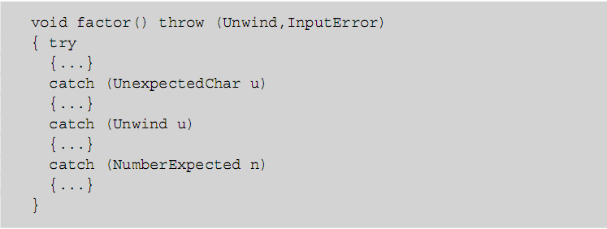
Exception Handling and Environments (cont’d.)
Example:
Programming Languages, Third Edition

Slide 96
Case Study: Processing Parameter Modes in TinyAda
In TinyAda:
  An identifier can be a parameter
  Parameters are subject to the same restrictions as variables
  Neither parameters nor variables can appear in static expressions
Parameters can be further specified in terms of the roles they play, called parameter modes
  Modes allow us to apply a new set of constraints during semantic analysis
Programming Languages, Third Edition

Slide 97
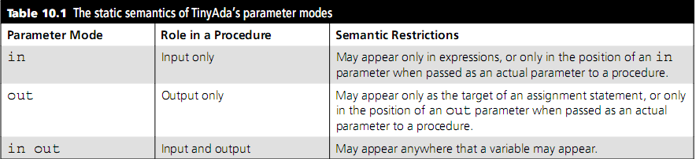
The Syntax and Semantics of Parameter Modes
Syntax rules for TinyAda’s parameter modes:
Programming Languages, Third Edition

Slide 98
Processing Parameter Declarations
The SymbolEntry class is modified to include a mode field
  Possible values are SymbolEntry.IN, SymbolEntry.OUT, and SymbolEntry.IN_OUT
Programming Languages, Third Edition

Slide 99
Processing Parameter References
If a name in an expression is a parameter, then its mode cannot be OUT
If a name in the target of an assignment statement is a parameter, then its mode cannot be IN
The number and types of actual parameters must be matched against the procedure’s formal parameters
  The mode must also now be examined to apply the new constraints
Programming Languages, Third Edition

